Slide 1

https://www.uni-goettingen.de/en/48115.html
More ‘Transition from Qualitative Genetics to Quantitative Genetics’.
UNPLAB-QuGen:Ch-3[Transition II]
1

Slide 2
Sequential Number: #37
UNPLAB-QuGen:Ch-3[Transition II]
Unless I explicitly state otherwise, images and cartoons are created using ChatGPT.
You may use this material free of charge under the terms of the CC BY license. This requires that you provide appropriate attribution to the author: W. Link, University of Goettingen, Germany.
In a few cases, individual images, photographs, or similar material may be subject to a more restrictive Creative Commons license. Where this applies, it is explicitly indicated, and you must comply with the stated license terms for those items.
Please check the license information carefully before reuse. Responsibility for complying with the applicable license terms rests entirely with you.
This symbol usually indicates that a page is rather important
2

Slide 3
You already know:
Keywords of this chapter:
Diversity vs. Variance; Normal Distribution and Variance; More than one trait to breed for; Qualitative vs. quantitative variation aka monogenic vs. polygenic variance; Impact of allele frequencies on variance, impact of selection of variance.
Algebra as introduced in this chapter is Binomial Algebra.
We scale a probability scale from 0-1 (0=AA absent; 1=AA present) making a mean of Ø=0.5 per locus because of p=q=0.5; 100% homozygosity.
From this we get σ² = (p ∙ q)/N, and N is the number of loci.
We scale based on the same genetics a number’s range from 0 to N and we have the corresponding mean. Then we get σ² = p ∙ q ∙ N, and N is the number of loci.
See below.
3

Slide 4
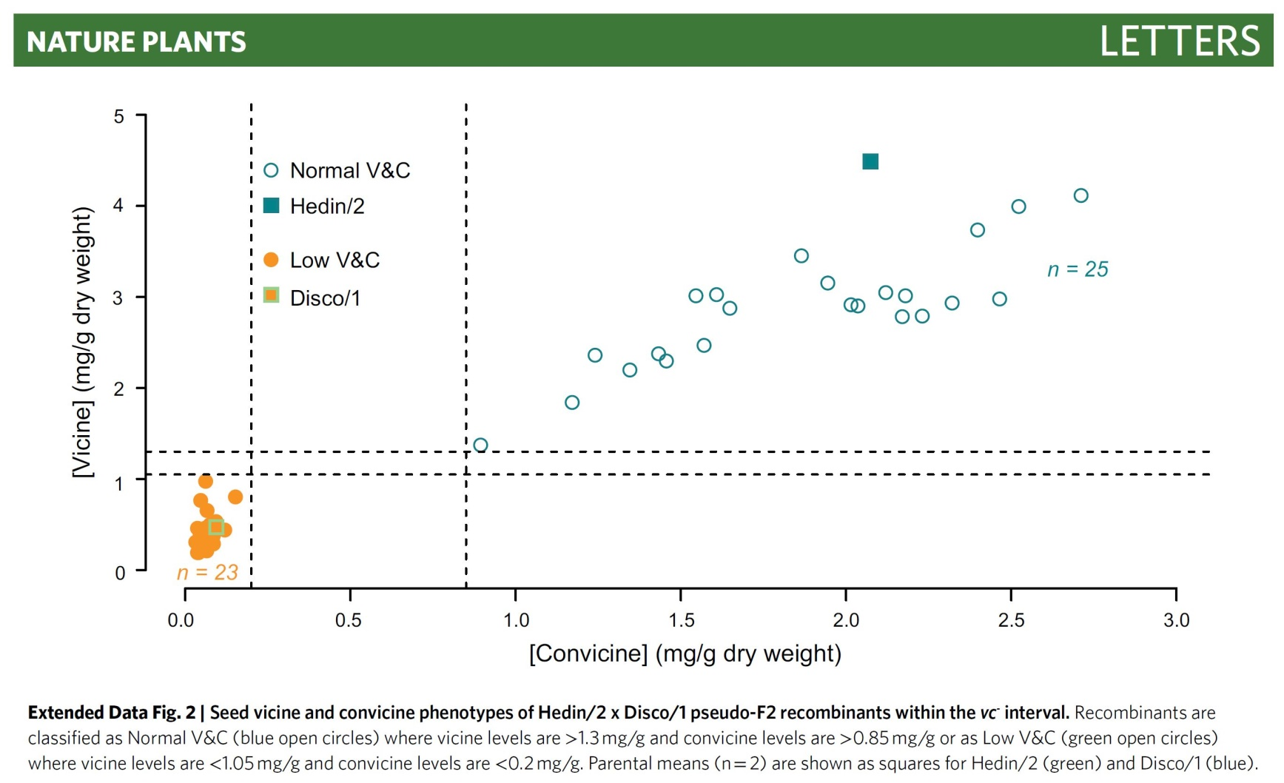
Plant Breeding exist only if there is gene-tic variation (ex-ploited by se-lection).
Here: Exam-ple for both, qualitative and quantitative genetic variation.
N=25
N=23
Two genotype groups: N=23 entries „low“ and N=25 entries „normal“. One causative major gene. Minor genes cause the genetic variation within the „normal“ group.
DOI: 10.1101/2020.02.26.966523, 10.1038/s41477-021-00950-w, Björnsdotter et al., 2020.
4

Slide 5

Vicine and convicine are anti-nutritive com-pounds in the seeds of faba bean (Vicia faba). Recently, the gene “vc-“ was identi-fied („RIBA1“). It is is one of the alleles of a major QTL for this trait, and homozygous
vc-/vc- genotypes have a dramatically lowered vicine and convicine content (about 1/10 to 1/20) of the „normal“ aka „wild-type“ content.
This is an example for qualitative, monogenic variation: very low content versus ‘normal’ content.
Yet, this is as well an example for quantitative variation: There is genetic variation within the ‘normal’ group. So-called minor genes segregate and cause ‘minor’ (yet sizable) differences in vicine-convicine content between the genotypes of that group.
Puspitasari et al. (2022) reported n=47 SNP markers with a significant association to such putative minor genes (minor QTLs). See: DOI 10.3389/fpls.2025.1565210.
5

Slide 6

N=25
‚Mute‘
Even in “normal” germplasm, the RIBA1 gene (RIBA1 locus) is present – but mute.
►“Locus exists” vs. “Locus segregates and causes genetic variation”. Only the latter is relevant for breeding. Non-segregating loci are muted; kind-of useless for us, but are of course usually necessary to sustain normal metabolism and live.
6

Slide 7
We invest a moment to contemplate the term ‘Diversity’ and the term ‘Variance’ ...
(Mannigfaltigkeit, Diversität, Variabilität, Varianz)
7

Slide 8
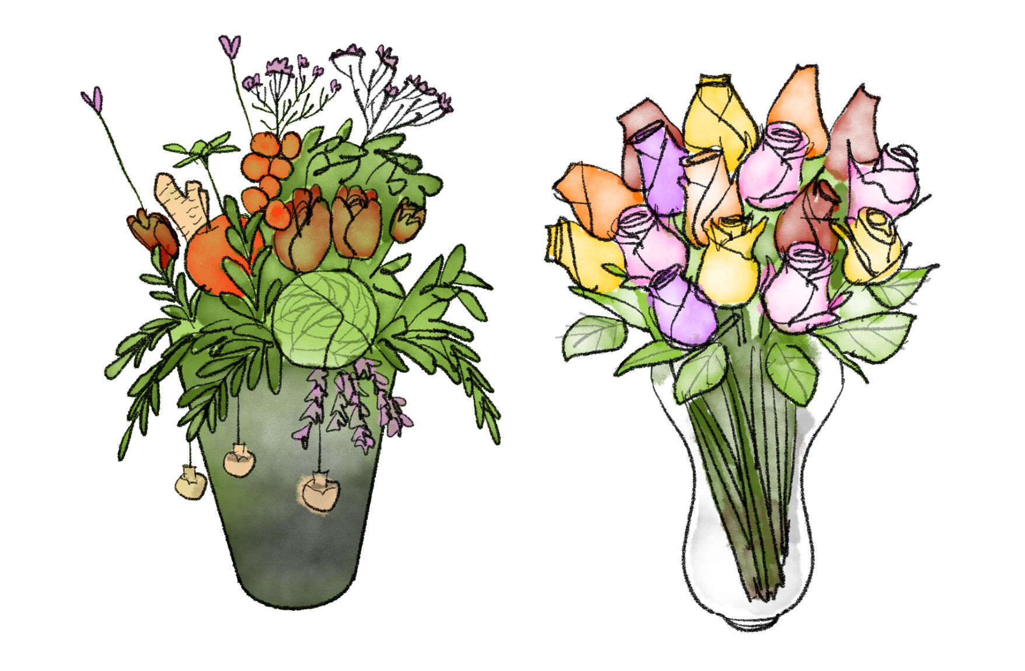

Brighter colours make higher diversity?
© Henri Laugel
8

Slide 9
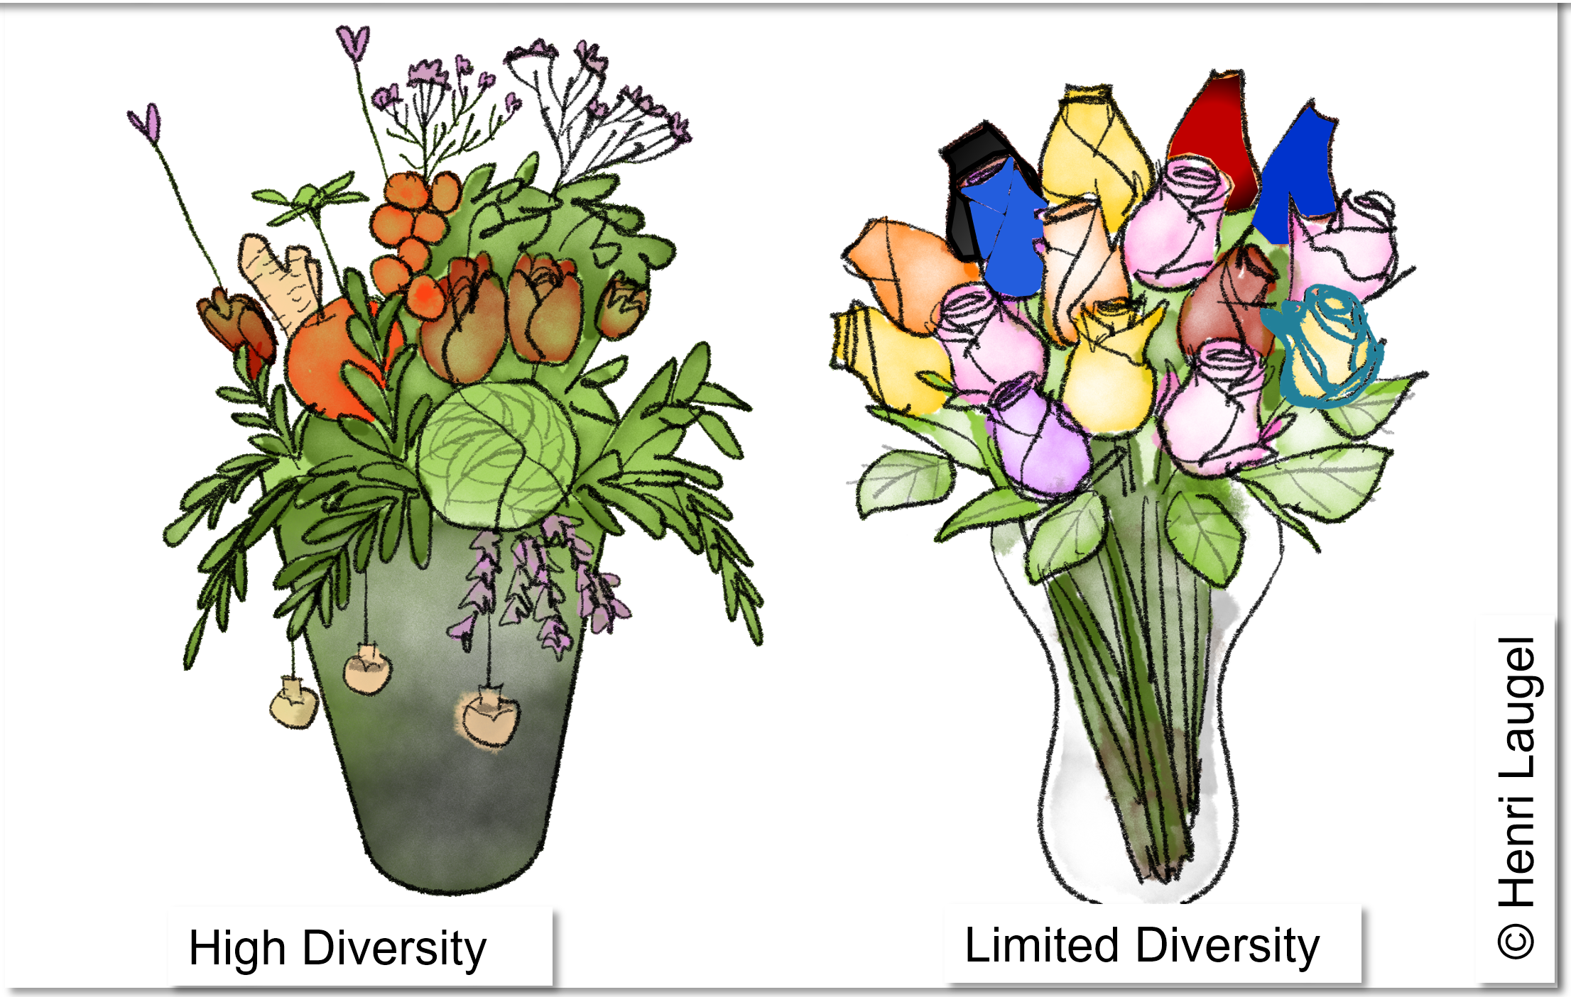
Diversity (Mannigfaltigkeit) talks about differences in many as-pects. Left bouquet (several species) is more ‘diverse’ than the right one, which is just roses.
To enable Algebra, we like to have data with clear scale, unit, metric. Instead of the flowery ;-) notion of ‘Diversity’ we typically use the concept of ‘Variance’ (amount of diversity yet restricted on one scale).
Variance would report the Diversity of e.g. the ‘flavonoid content of leaf petals’; or of ‘water content of the leaves’; or of some other measurable, specific single trait.
You anyway know: Calculate variance as differences between all values to their com-mon mean; then square them; then calculate the mean of the squares. Variance is sometimes called ‘Mean of Squares; MS’ (https://en.wikipedia.org/wiki/variance).
9

Slide 10
Variance.
This concept preferentially resides on the idea of a continuous, normal distribution. Yet, loci and their alleles are discrete entities, and so are their effects on the phenotype differences of living individuals.
Let us inspect this discrepancy – if there is any.
10

Slide 11
Variance. Continuous Distribution.
Be prepared to see values per genotype created as sum-of-action of N=3 loci on next page
Basic statistics says: Variance of a binomially distributed variable is σ² = Npq
11

Slide 12
Variance. Continuous Distribution.
You may as well write BB & bb and CC & cc in loci 2 and 3.
Flip N=3 coins.
Values of the 3 loci are exactly uncorrelated - otherwise ... see later ;-)
12

Slide 13
Variance. Continuous Distribution.
*Probability of
‘1’ is 2 in 3 ...
et cetera
Scale 0-1: Here, variance from 3 loci is smaller (0.08$\overline{3}$ < 0.25) than from 1 locus.
13

Slide 14
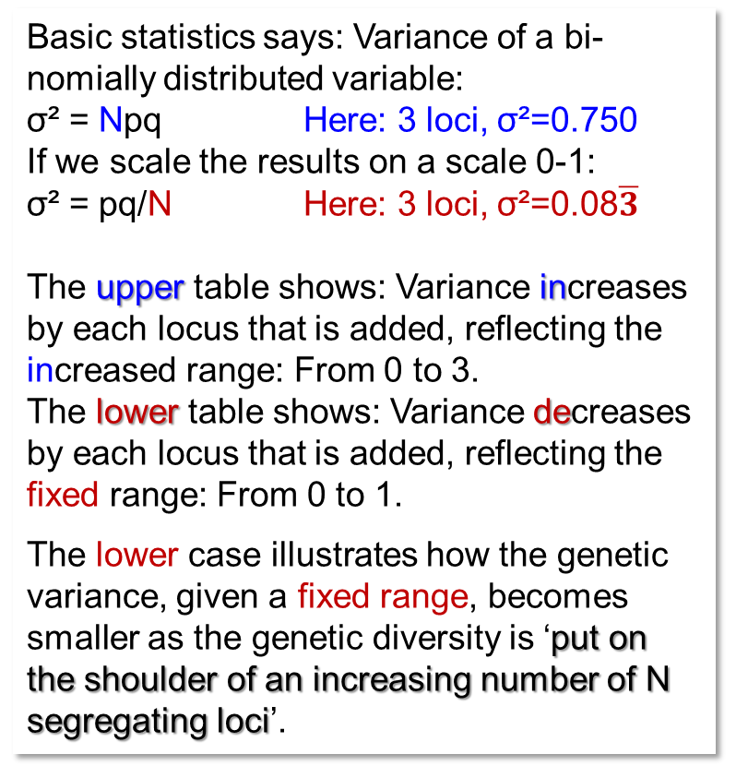
Basic statistics says: Variance of a bi-nomially distributed variable:
σ² = Npq Here: 3 loci, σ²=0.750
If we scale the results on a scale 0-1:
σ² = pq/N Here: 3 loci, σ²=0.08$\overline{3}$
The upper table shows: Variance increases by each locus that is added, reflecting the increased range: From 0 to 3.
The lower table shows: Variance decreases by each locus that is added, reflecting the fixed range: From 0 to 1.
The lower case illustrates how the genetic variance, given a fixed range, becomes smaller as the genetic diversity is ‘put on the shoulder of an increasing number of N segregating loci’.
14
14

Slide 15
The upper table says: If in your breeding material only one of three loci segregates, then you increase the genetic variance by introducing alien germplasm so that the second and third locus segregates, too. For instance make crosses with exotic material of Crop Wild Relatives (https://cwr.croptrust.org).
The lower table says: If you go from mono-genic to polygenic and - for the purpose of comparability – you keep the range con-stant (0.0 - 1.0), then the more loci jointly cause the trait variation, the smaller the resulting variance is.
Taste and enjoy the excitement of two perspectives.
15
15

Slide 16
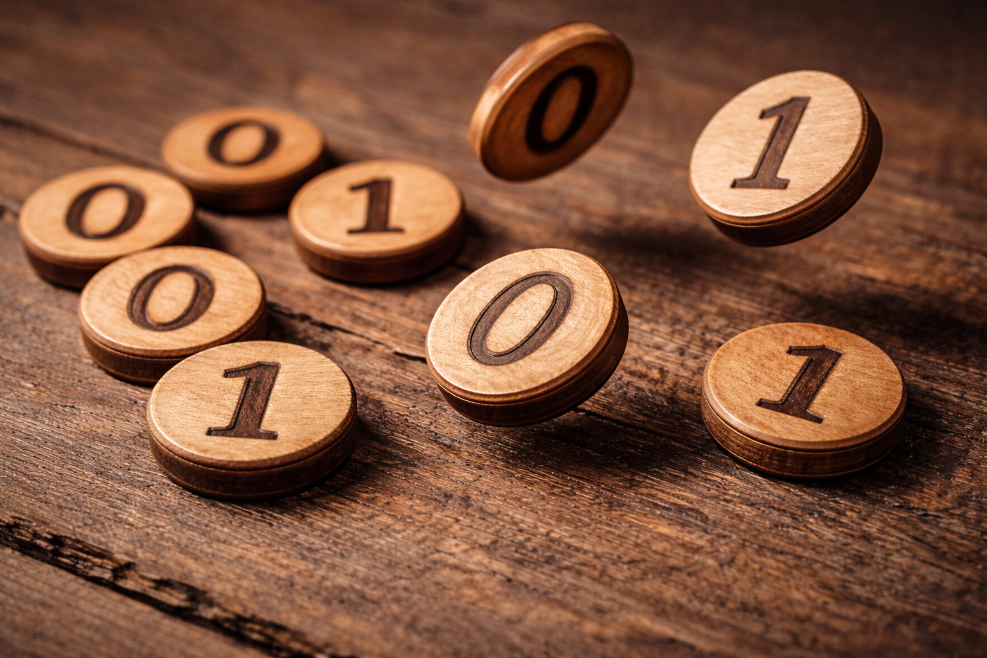
Counting is not this AI's core competency; eight or ten (see below) coins would have been nice but AI was stubborn.
16

Slide 17
Examples with 12 loci: Discrete to continuous.
10 or 12 is neither very few nor really many ... “Transition”
12 loci, all with same effect (0 vs. 1). Allele frequency is always 0.5 except locus 1 (fixed for aa) and locus 12 (fixed for AA).
Max. possible genetic value is 11 (because locus 1 is fixed for aa).
Minimum genetic value is 1 (because locus 12 is fixed for AA).
►10 loci segregate.
Here, genetic variance is
σ²= 0.5² ∙ 10 = 2.50.
Here, the genetic standard deviation is (2.5)⁰⁵ = 1.581.
0.35
0.30
Range of possible trait values
0.25
0.20
Frequency of occurrence
0.15
0.5¹⁰=
0.0009766
0.5¹⁰=
0.0009766
0.10
0.05
0.00
0
1
2
3
4
5
6
7
8
9
10
11
12
Genetic value of DH genotypes
17

Slide 18
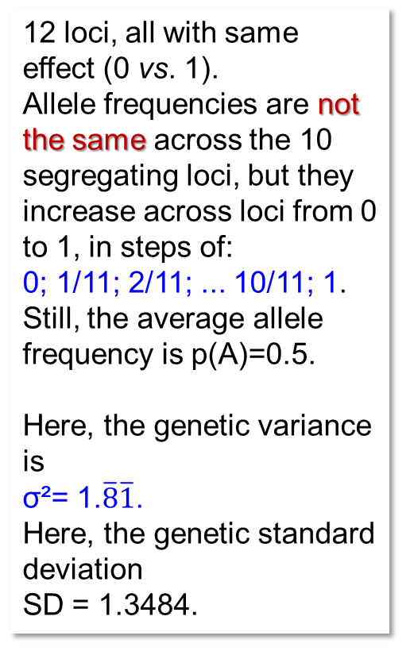
Examples with 12 loci: Discrete to continuous.
12 loci, all with same effect (0 vs. 1).
Allele frequencies are not the same across the 10 segregating loci, but they
increase across loci from 0 to 1, in steps of:
0; 1/11; 2/11; ... 10/11; 1.
Still, the average allele
frequency is p(A)=0.5.
Here, the genetic variance is
σ²= 1.$\overline{8}\overline{1}$.
Here, the genetic standard deviation
SD = 1.3484.
0.35
0.30
0.25
0.20
Frequency of occurrence
0.15
0.00014
0.10
0.05
0.00
0
1
2
3
4
5
6
7
8
9
10
11
12
Genetic value of DH genotypes
18

Slide 19
Examples with 12 loci: Discrete to continuous.
12 loci, all with same effect (0 vs. 1). Genotype fre-
quency of ‘AA’ increases: P(AA)=0 at locus 1 ... then
0.05; 0.10; 0.15; 0.20; 0.25
0.75; 0.80; 0.85; 0.90; 0.95
... until p(A)=1 at locus 12.
Intermediate allele fre-quencies do not occur.
Ø frequency is still 0.5.
Genetic variance is
σ² = 1.225.
Genetic standard dev. is SD = 1.1068.
You notice that we keep Ø frequency at 0.5; yet the distribution of single loci frequencies be-come less artificial ;-)
0.35
0.30
0.25
0.20
Frequency of occurrence
0.15
0.0000164
0.10
0.05
0.00
0
1
2
3
4
5
6
7
8
9
10
11
12
Genetic value of DH genotypes
19

Slide 20
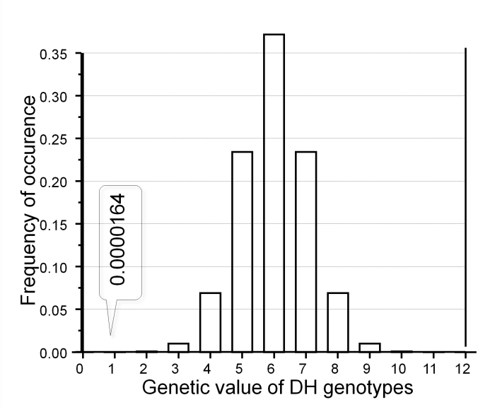
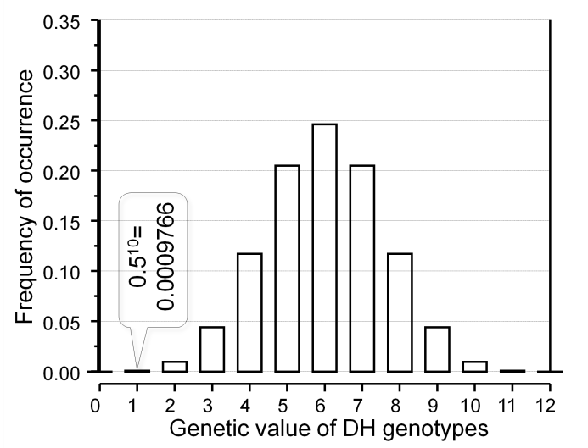
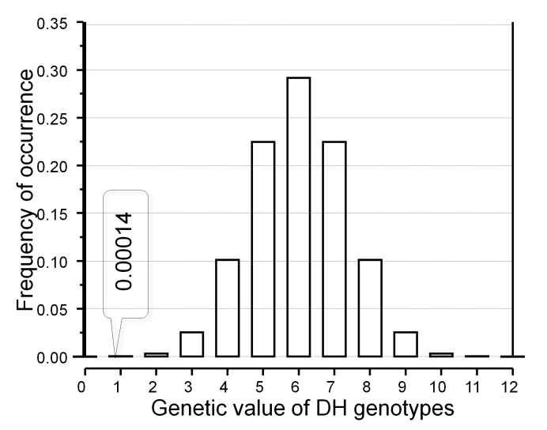

12 loci, distribution near to normal.
σ²=2.50
σ²= 1.$\overline{8}\overline{1}$
σ²=1.225
The more the allele frequencies deviate from being all p=0.5, the smaller the variance is (left: always 0.5; central: from 0.0 in 12 steps of 1/11 up to 1.0; right: no locus with intermediate frequency 0.25 < p < 0.75). The smaller the variance, the rarer the extreme genotypes (0.0009766 > 0.0001400 < 0.0000164).
Enjoy the ‘normal’ drama of Plant Breeding, it is visible here:
►even if the genes (alleles) that indeed exist in the germplasm allowed a very extreme genetic value (performance): We more or less do not get such extreme type.
One reason is that its probability to occur is very low.
20

Slide 21
12 loci, distribution near to normal (still: homozygotes only).
σ²=2.50
σ²= 1.$\overline{8}\overline{1}$
σ²=1.225
With 12 loci, the distribution gets near to a normal distribution, yet not perfectly so.
The more the allele frequencies deviate from being all P=0.5, the smaller the variance is (left: always 0.5; central: from 0.0 in 12 steps of 1/11 up to 1.0; right: no locus with intermediate frequency 0.25 < p < 0.75). The smaller the variance, the rarer the extreme genotypes (frequencies of those with genetic value of 1 is indicated).
Enjoy the ‘normal’ drama of Plant Breeding, it is visible here:
►Even if the genes (alleles) that indeed exist in the germplasm allowed a very ex-treme genetic value (such as 1 or 11): We more or less do not see such extreme geno-types realized. One reason is that their ‘probability to occur’ is very low.
21

Slide 22
The following diagrams show, amongst several aspects, that Selection (increase the frequency of ‘good’ alleles at the expense of the other ones) can – in cases – increase instead of decrease variance.
I repeat the message: Selection = Exploitation!
But not necessarily it decreases – as expected – the available genetic variance.
22

Slide 23
We increase the frequency of the “A” allele in steps, from 10% to 90% (remember that so far all genotypes are homozygous* - meaning that the frequency of “A” in the population is identical with the frequency of “AA” genotypes in the population! 
See how – for the next eight pages – the frequency P of genotypes (AA) in the populations increases and simultaneously mean µ and variance (and SD, of course) of the population change accordingly.
*DH ;-)
23

Slide 24
Impact of Allele Frequency on Genetic Variance
0.4
Genotype frequency at 10
“AA” is 10% here.
Well.
The first of the 12 assumed loci is still fixed for aa.
The last of the 12 loci is still fixed for AA (or, say LL, which is letter number 12 in the alphabet).
The 10 loci in-between (from B to K) have the large-letter allele with 10% probability.
Okay?
segregating loci: P(AA)=10%
0.3
Variance = 0.90
SD = 0.9487
Probability of occurrence
0.2
µ
0.1
0.0
1
2
3
4
5
6
7
8
9
10
11
12
Genetic value
24

Slide 25
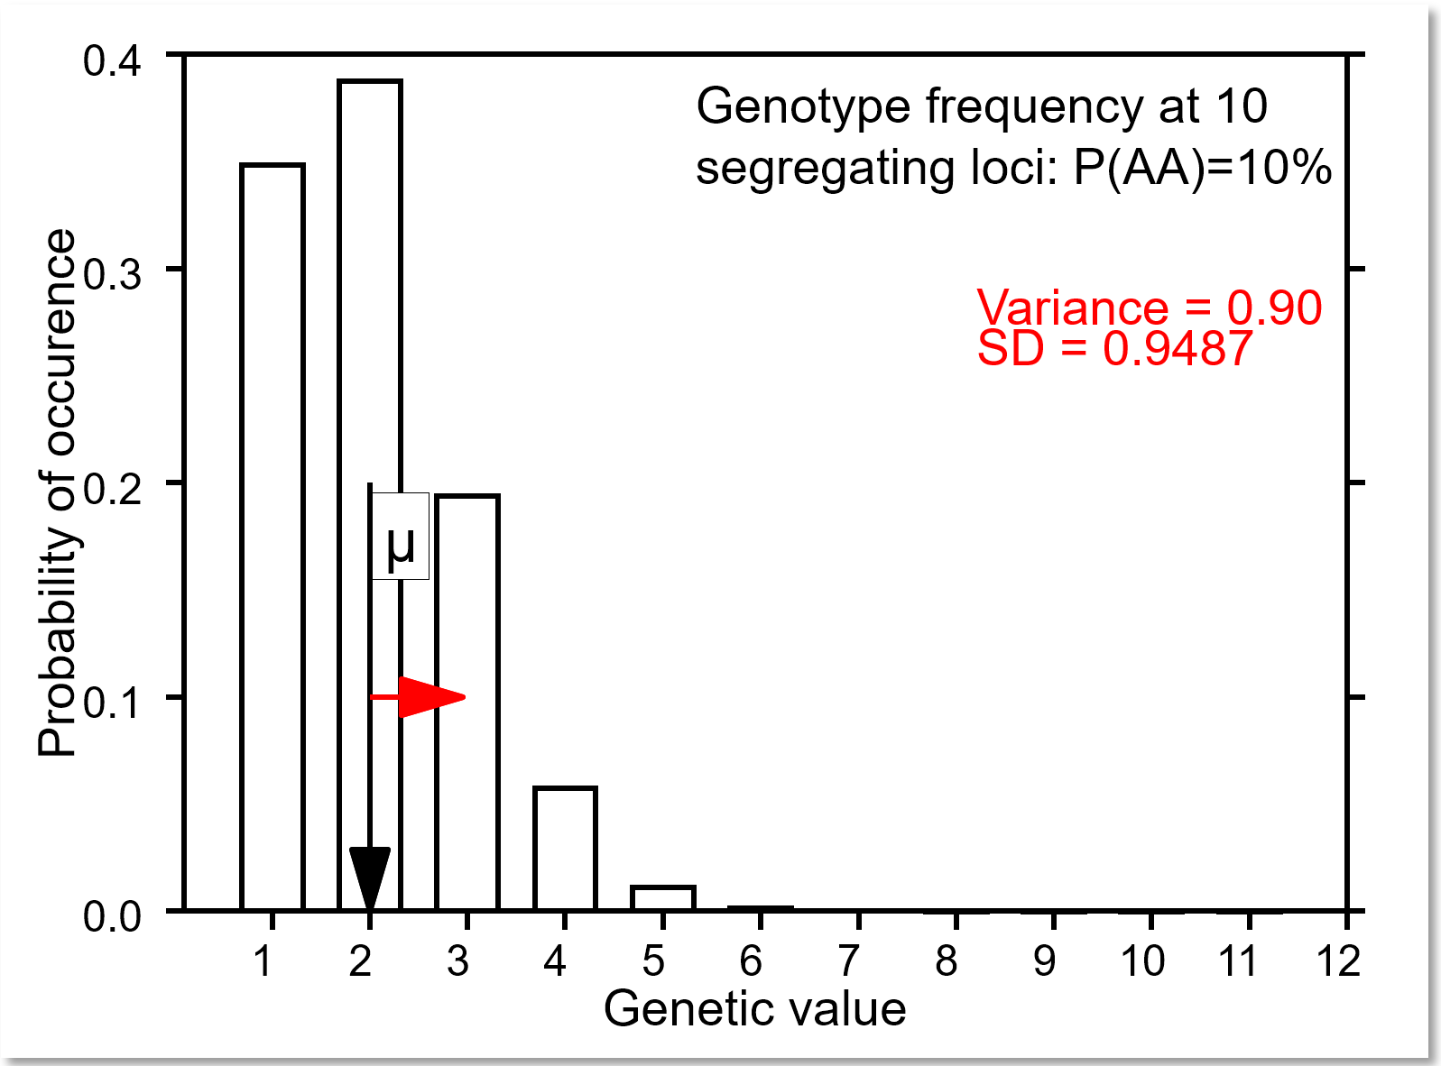
Impact of Allele Frequency on Genetic Variance
Frequency of ‘good’ allele at locus 2 to 11 = 0.1. These 10 genotypes make then the most frequent group (genetic value=2 ):
Locus #
Gen. 1 2 3 4 5 6 7 8 9 10 11 12
1 aa; BB; cc; dd; ee; ff; gg; hh; ii; jj; kk; LL
2 aa; bb; CC; dd; ee; ff; gg; hh; ii; jj; kk; LL
3 aa; bb; cc; DD; ee; ff; gg; hh; ii; jj; kk; LL
4 aa; bb; cc; dd; EE; ff; gg; hh; ii; jj; kk; LL
5 aa; bb; cc; dd; ee; FF; gg; hh; ii; jj; kk; LL
6 aa; bb; cc; dd; ee; ff; GG; hh; ii; jj; kk; LL
7 aa; bb; cc; dd; ee; ff; gg; HH; ii; jj; kk; LL
8 aa; bb; cc; dd; ee; ff; gg; hh; II; jj; kk; LL
9 aa; bb; cc; dd; ee; ff; gg; hh; ii; JJ; kk; LL
10 aa; bb; cc; dd; ee; ff; gg; hh; ii; jj; KK; LL
0.38742
With 10%, each of these 10 types occurs with P= 1 ∙ 0.9⁹ ∙ 0.1 ∙ 1 = 0.038742.
Together, these 10 types are one group with genetic value = 2, their joint frequency is then 10 ∙ 0.038742 = 0.38742 - as shown in the diagram.
25

Slide 26
Impact of Allele Frequency on Genetic Variance
Now we really start.
Here, we still have p(A)=P(AA)=10%
See how - page per page - p(AA) increases and simultaneously mean µ and Standard Deviation change accordingly
0.4
Genotype frequency at 10
segregating loci: P(AA)=10%
0.3
Variance = 0.90
SD = 0.9487
Probability of occurrence
0.2
µ
0.1
0.0
1
2
3
4
5
6
7
8
9
10
11
12
Genetic value
26

Slide 27
Impact of Allele Frequency on Genetic Variance
0.4
But now, p(A)=P(AA)=20%
From page to page, the frequency of the AA genotypes is step-wise increased. Follow the effect on the population’s mean µ and variance (i.e., SD) with your eyes.
Genotype frequency at 10
segregating loci: P(AA)=20%
0.3
Variance = 1.60
SD = 1.2649
Probability of occurrence
0.2
µ
0.1
0.0
1
2
3
4
5
6
7
8
9
10
11
12
Genetic value
27

Slide 28
Impact of Allele Frequency on Genetic Variance
0.4
Genotype frequency at 10
segregating loci: P(AA)=30%
0.3
Variance = 2.1
SD = 1.4491
Probability of occurrence
0.2
µ
0.1
0.0
1
2
3
4
5
6
7
8
9
10
11
12
Genetic value
28

Slide 29
Impact of Allele Frequency on Genetic Variance
0.4
Genotype frequency at 10
segregating loci: P(AA)=40%
0.3
Variance = 2.4
SD = 1.5492
Probability of occurrence
0.2
µ
0.1
0.0
1
2
3
4
5
6
7
8
9
10
11
12
Genetic value
29

Slide 30
Impact of Allele Frequency on Genetic Variance
Variance is – here – maximum with P(AA)=0.5.
Variance is increased if we increase P(AA) from low values towards 0.5.
Breeding, hence selection, may increase and may decrease (next pages) genetic variance.
0.4
Genotype frequency at 10
segregating loci: P(AA)=50%
0.3
Variance = 2.5
SD = 1.581
Probability of occurrence
0.2
µ
0.1
0.0
1
2
3
4
5
6
7
8
9
10
11
12
Genetic value
30

Slide 31
Impact of Allele Frequency on Genetic Variance
0.4
Genotype frequency at 10
segregating loci: P(AA)=60%
0.3
Variance = 2.4
SD = 1.5492
Probability of occurrence
0.2
µ
0.1
0.0
1
2
3
4
5
6
7
8
9
10
11
12
Genetic value
31

Slide 32
Impact of Allele Frequency on Genetic Variance
0.4
Genotype frequency at 10
segregating loci: P(AA)=70%
0.3
Variance = 2.1
SD = 1.4491
Probability of occurrence
0.2
µ
0.1
0.0
1
2
3
4
5
6
7
8
9
10
11
12
Genetic value
32

Slide 33
Impact of Allele Frequency on Genetic Variance
0.4
Genotype frequency at 10
segregating loci: P(AA)=80%
0.3
Variance = 1.60
SD = 1.2649
Probability of occurrence
0.2
µ
0.1
0.0
1
2
3
4
5
6
7
8
9
10
11
12
Genetic value
33

Slide 34
Impact of Allele Frequency on Genetic Variance
0.4
As “AA” increases, so, as “aa” decreases, we see an increase of the mean performance, and we see an impact on the genetic variance.
Genotype frequency at 10
segregating loci: P(AA)=90%
0.3
Variance = 0.90
SD = 0.9487
Probability of occurrence
0.2
µ
We see as well that the distribution is not any more symmetrical; and obviously, the shape of the Gaussian, ‘normal’ distribution does notwell approximate this binomial-based distribution.
0.1
0.0
1
2
3
4
5
6
7
8
9
10
11
12
Genetic value
34

Slide 35
Why is there no diagram with
“all loci at 0%” or with
“all loci at 100%”?
35

Slide 36
Impact of increasing frequency of AA on µ and σ²
Population mean µ
Mind: We are still looking at the homozygous population.
Impact of increasing the fre-quency of AA on value and variance.
Well, not literally AA, but BB and/or CC and/or ... KK, anyway: Impact of increasing frequency of large-letter allele per locus, the ones which are coding for impact ►1 to the trait
(instead of ►0, which is here the effect of the small-letter alleles).
Mean of 1/3 highest fraction
3
11
Variance
Standard Dev.
10
2.5
9
8
2
7
Variance or SD
Pop. mean or mean of 1/3 highest
6
5
1
4
3
2
0
1
0.0
0.1
0.2
0.3
0.4
0.5
0.6
0.7
0.8
0.9
1.0
Frequency of 'AA' at each of 10
segregating loci
36

Slide 37
Impact of increasing frequency of AA on µ and σ²
Impact of increasing the frequency of AA on value and variance.
Well, not literally AA, but BB and/or CC and/or ... KK, anyway: Impact of increasing frequency of large-letter allele per locus, the ones which are coding for impact ►1 to the trait (instead of ►0, which is here the effect of the small-letter alleles).
Population mean µ
Mean of 1/3 highest fraction
3
11
Variance
Standard Dev.
10
9
8
2
7
Variance or SD
Pop. mean or mean of 1/3 highest
6
5
1
4
3
2
0
1
0.0
0.1
0.2
0.3
0.4
0.5
0.6
0.7
0.8
0.9
1.0
Frequency of 'AA' at each of 10
37
segregating loci

Slide 38
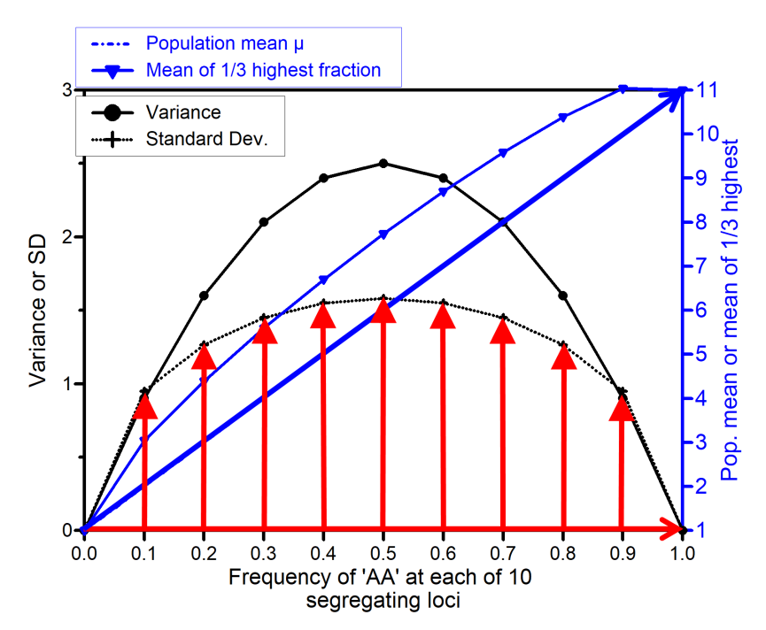
Impact of increasing frequency of AA on µ and σ²
Increase of frequency of large-letter alleles increases mean of the population. Such increase (improvement) typically results from breeders’ selection for ‘good’ (pheno-/geno-)type. If the initial AA frequency per locus is low (say 10%), then increase of frequency is - at first - increasing both: Mean performance and genetic variance in the population.
38
This is because: Variance is maximum with 50% frequency (σ² = Npq; with p=q, we have a ‘square situation’. |amongst all rectangles of perimeter p+q=1, the square (p=q) contains the largest area (largest product p∙q; perimeter = Umfang)>.|
Frequencies 0% and 100% are boring, because there is – then – zero variance.

Slide 39
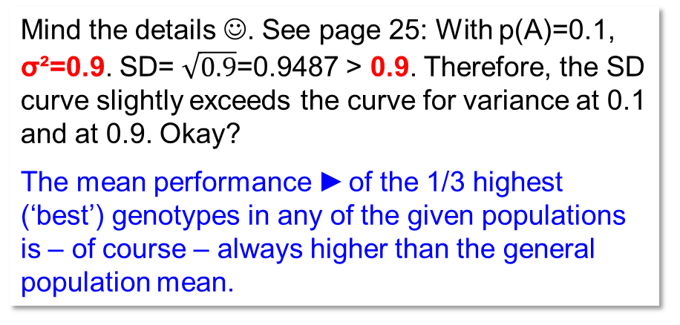
Mind the details ☺. See page 25: With p(A)=0.1, σ²=0.9. SD= $\sqrt{0.9}$=0.9487 > 0.9. Therefore, the SD curve slightly exceeds the curve for variance at 0.1 and at 0.9. Okay?
The mean performance ► of the 1/3 highest (‘best’) genotypes in any of the given populations is – of course – always higher than the general population mean.
39
Yet. Size of this superiority depends on the diversity (variance) in the actual population. Variance and superiority are maximum with fifty-fifty frequency of BB-bb, CC-cc etc.
By the way, superiority is 1.097 ∙1 SD (cf. UNPLAB-h²_GxE_Ch-4[Sel.Intensity]); this is if the data loyally and honestly follow the bell-shape of the Normal Distribution ... which is not exactly the case here. Therefore the mean of this 1/3 at 0.9 is - here - already shown as 11, (as 11.041 ☺ to be precise ... which is non-sense. Our scale limit is 11, yet the normal distribution ‘does not know this’, it exceeds this limit ... therefore ...?!)

Slide 40
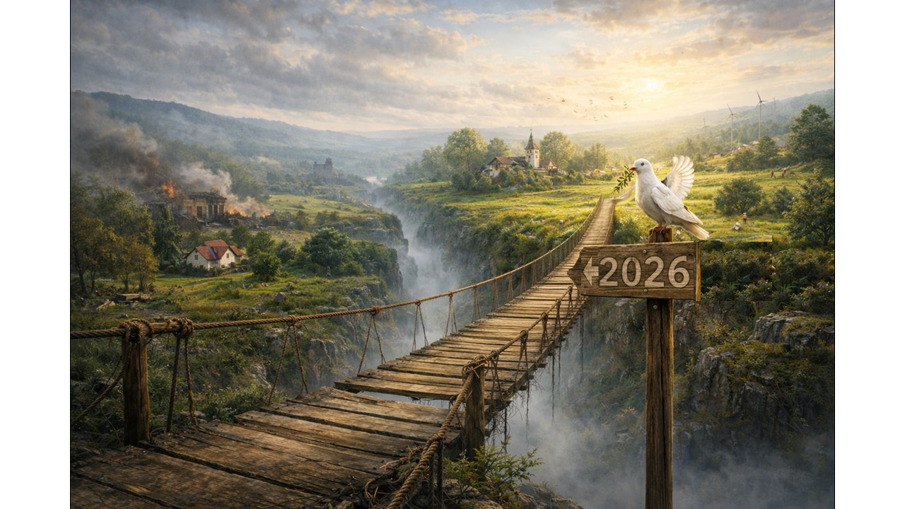
From here you may go to UNPLAB-QuGen_Ch-4[MetrMod]
I worked on this … you see when. I hope for the best – bismillah, inshallah. Pax vobiscum.
I use ChatGPT, by the way, because I hope it's a way to get around the copyright issues that could arise if I were to copy and paste such images from www instead; I won't say much more about it, I'm not promoting it, I don't own any shares in it. I planted five oak and hazelnut trees to mend our CO₂ footprint due to it.
40
40

